Slide 1

Phoenix CubeSat: Radiometric Work on the Payload Camera
Presented by Andre De Simone and Daniel La Rosa

Slide 2
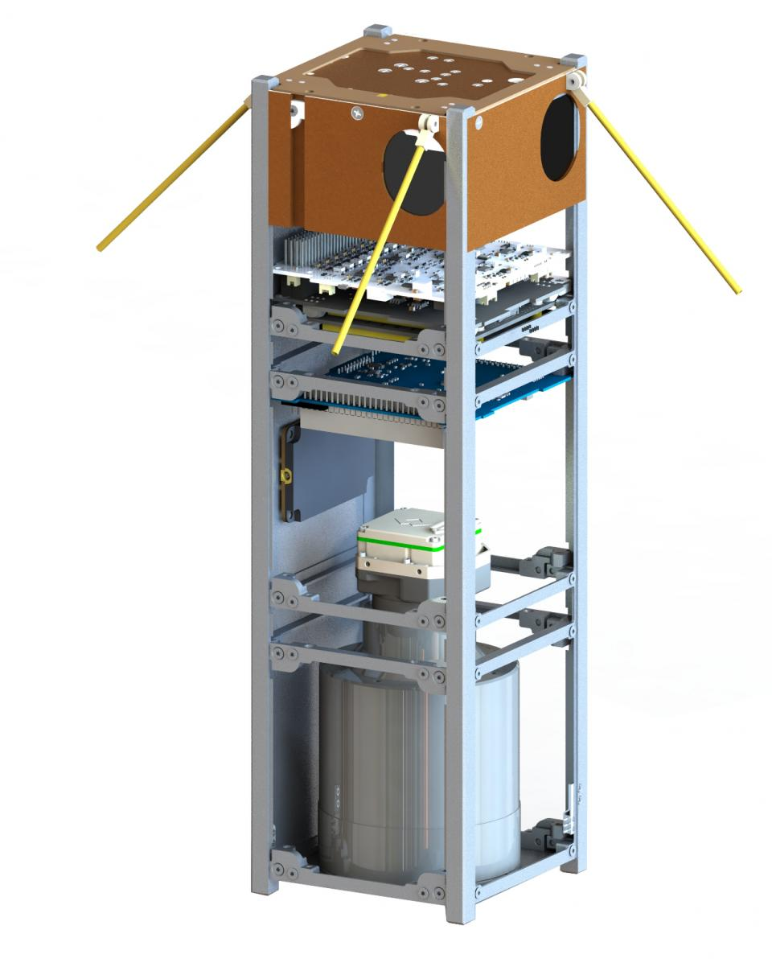
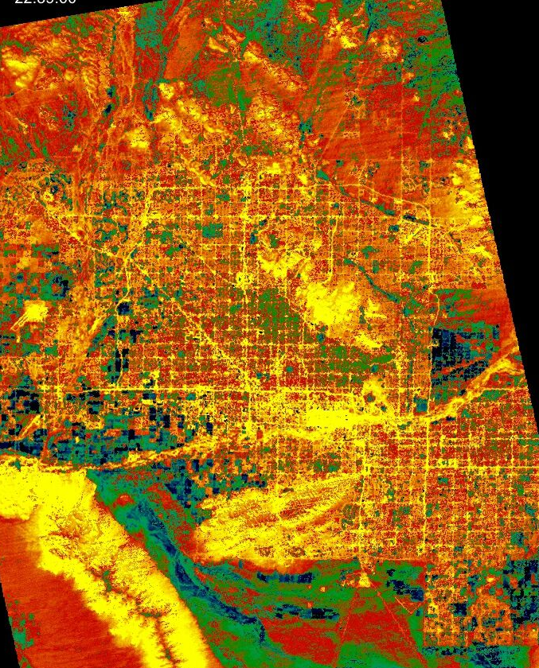
Overview
Notes:
Phoenix is a 3U CubeSat equipped with a FLIR Tau 2 thermal imaging camera. This payload will capture images of several different cities to study the urban heat island effect. Testing is conducted to verify performance on orbit, in particular to understand the effects of the atmosphere and vacuum on the thermal imaging performance. All this work involves a variety of skills that have been developed and advanced over the past year such as CAD modeling, MATLAB, Python, hardware interfacing, radiometric modeling, and image processing. Two projects were completed for the NASA Space Grant, one being a thermal-vacuum test. In the thermal-vacuum test the camera is placed in a thermal chamber and its temperature is increased over a set range. The camera is focused on a blackbody that serves as a tool to define the accuracy of the camera’s focal-plane array.

Slide 3
Thermal Vacuum Test

Slide 4
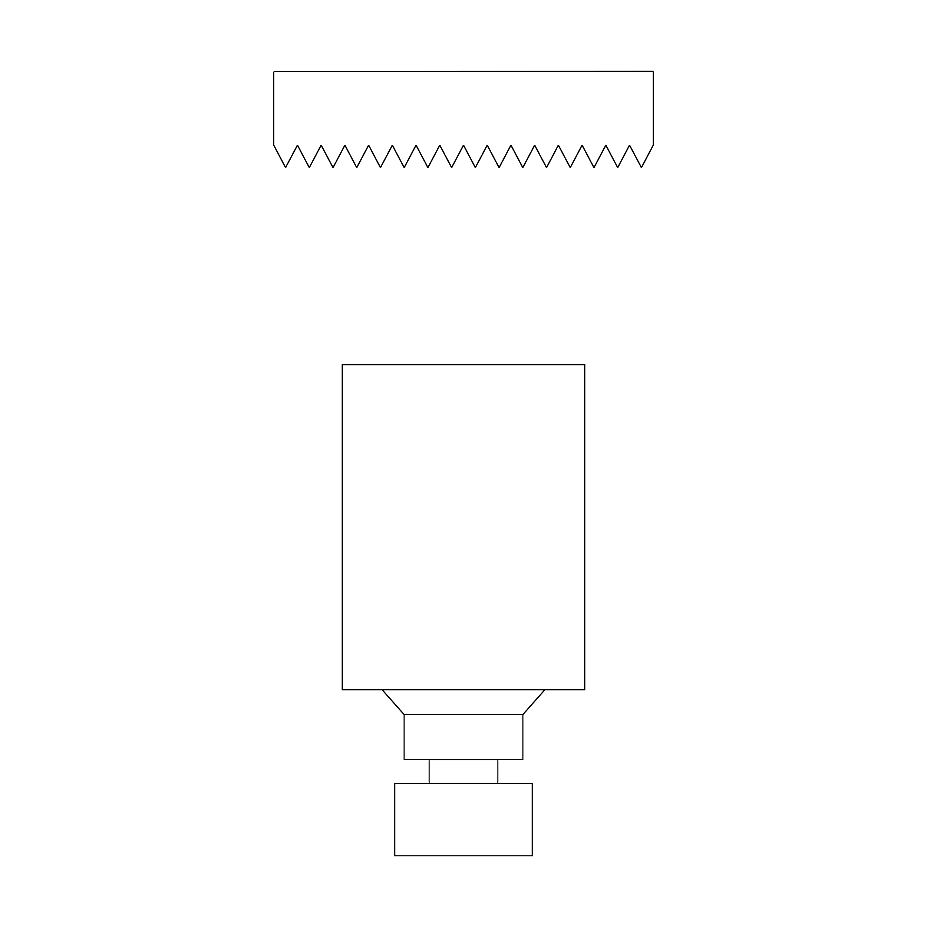
Thermal Vacuum Test - Overview
vacuum
A focal-plane array (FPA) is a sensor that detects infrared wavelengths and converts them into images.
Differences in FPA temperature may affect image value accuracy.
It is crucial to find the camera’s optimal operating temperature so that it with produce meaningful data.
Optimal FPA temperature can be found by pointing the camera at a blackbody and varying temperature while inside a vacuum chamber.
blackbody
FLIR Tau 2
FPA

Slide 5
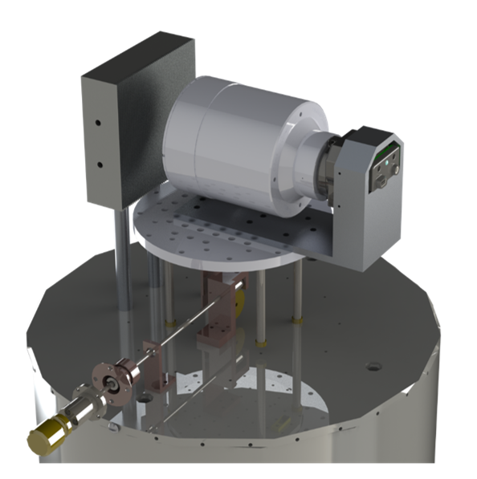
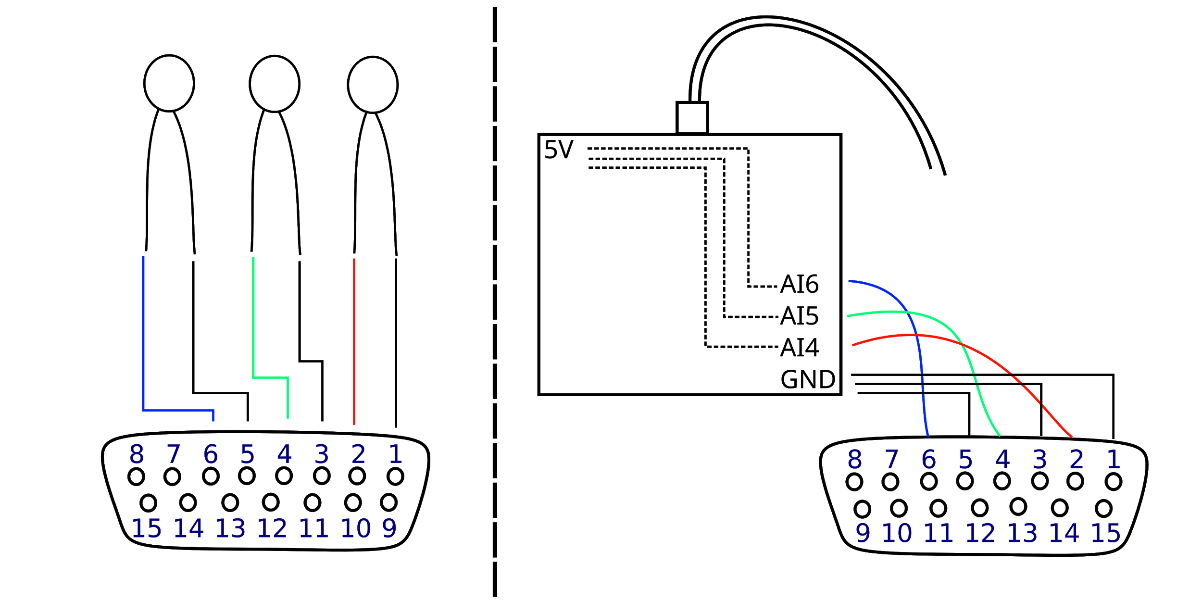
Thermal Vacuum Test - Setup
Thermistors
To Computer
DAQ
D-SUB
D15
Inside Vacuum Chamber
Outside Vacuum Chamber
Figure 1. Diagram of the thermistor setup.
Figure 2. T-VAC test setup CAD model.

Slide 6
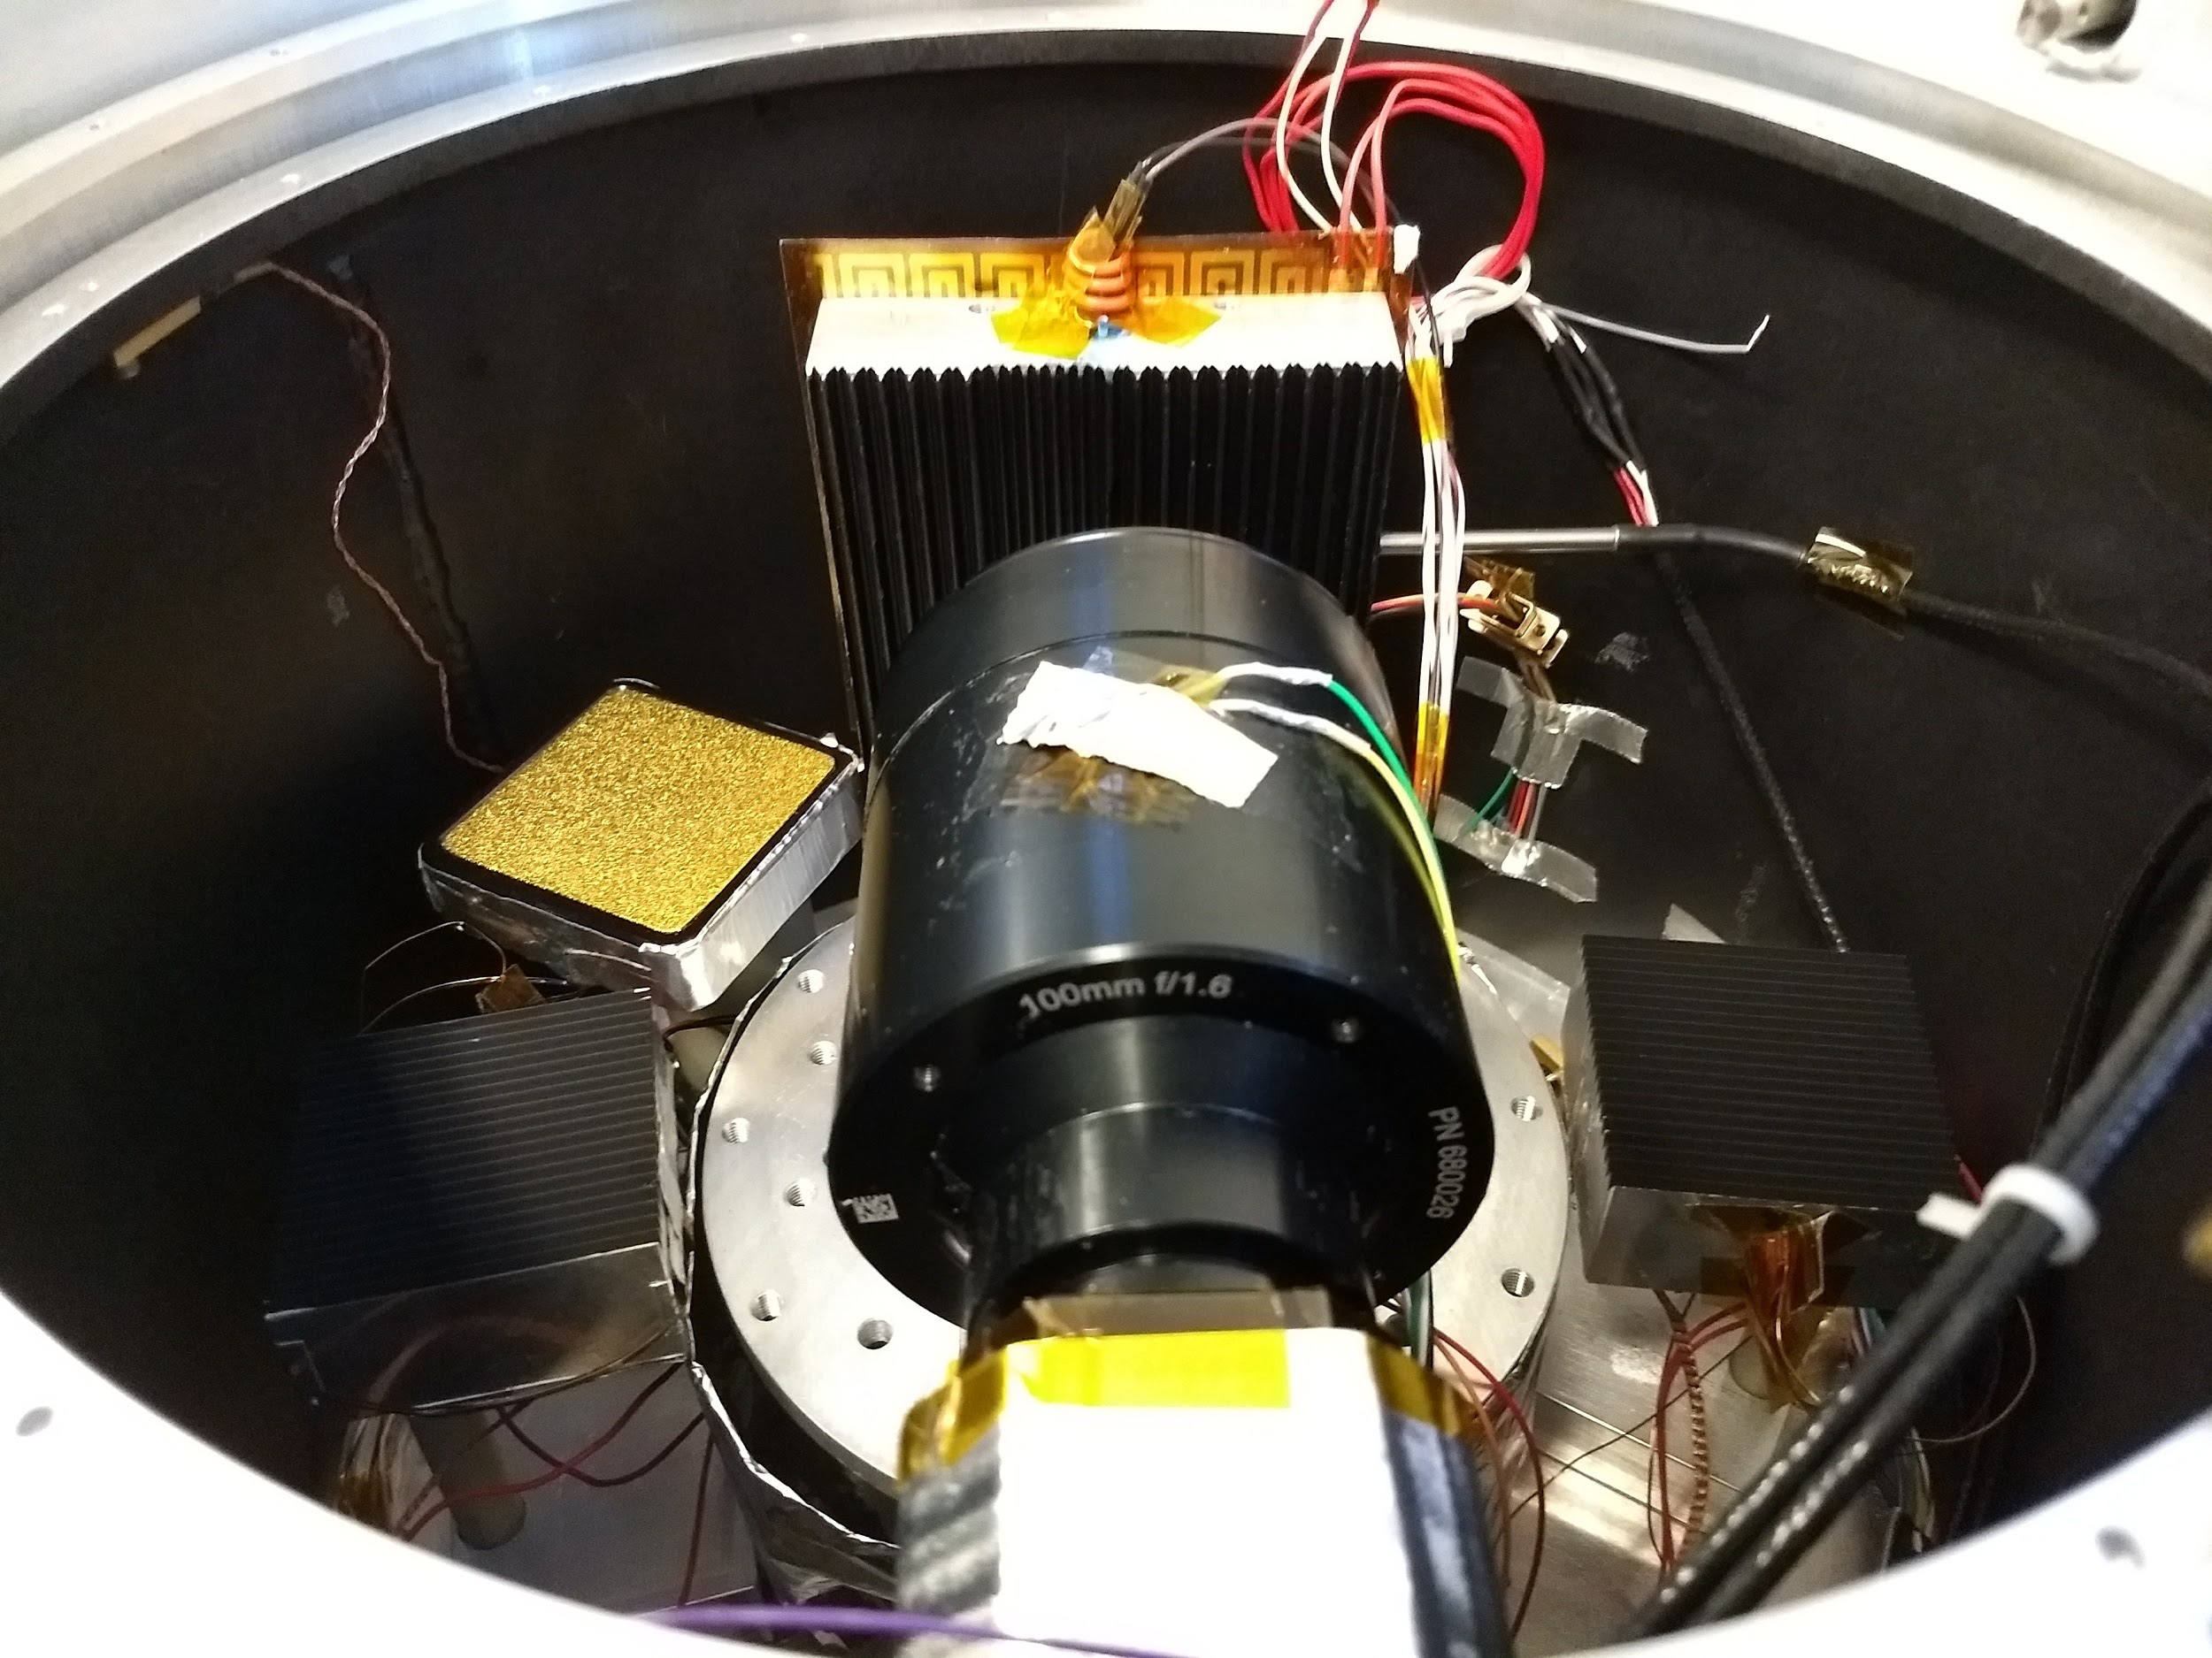
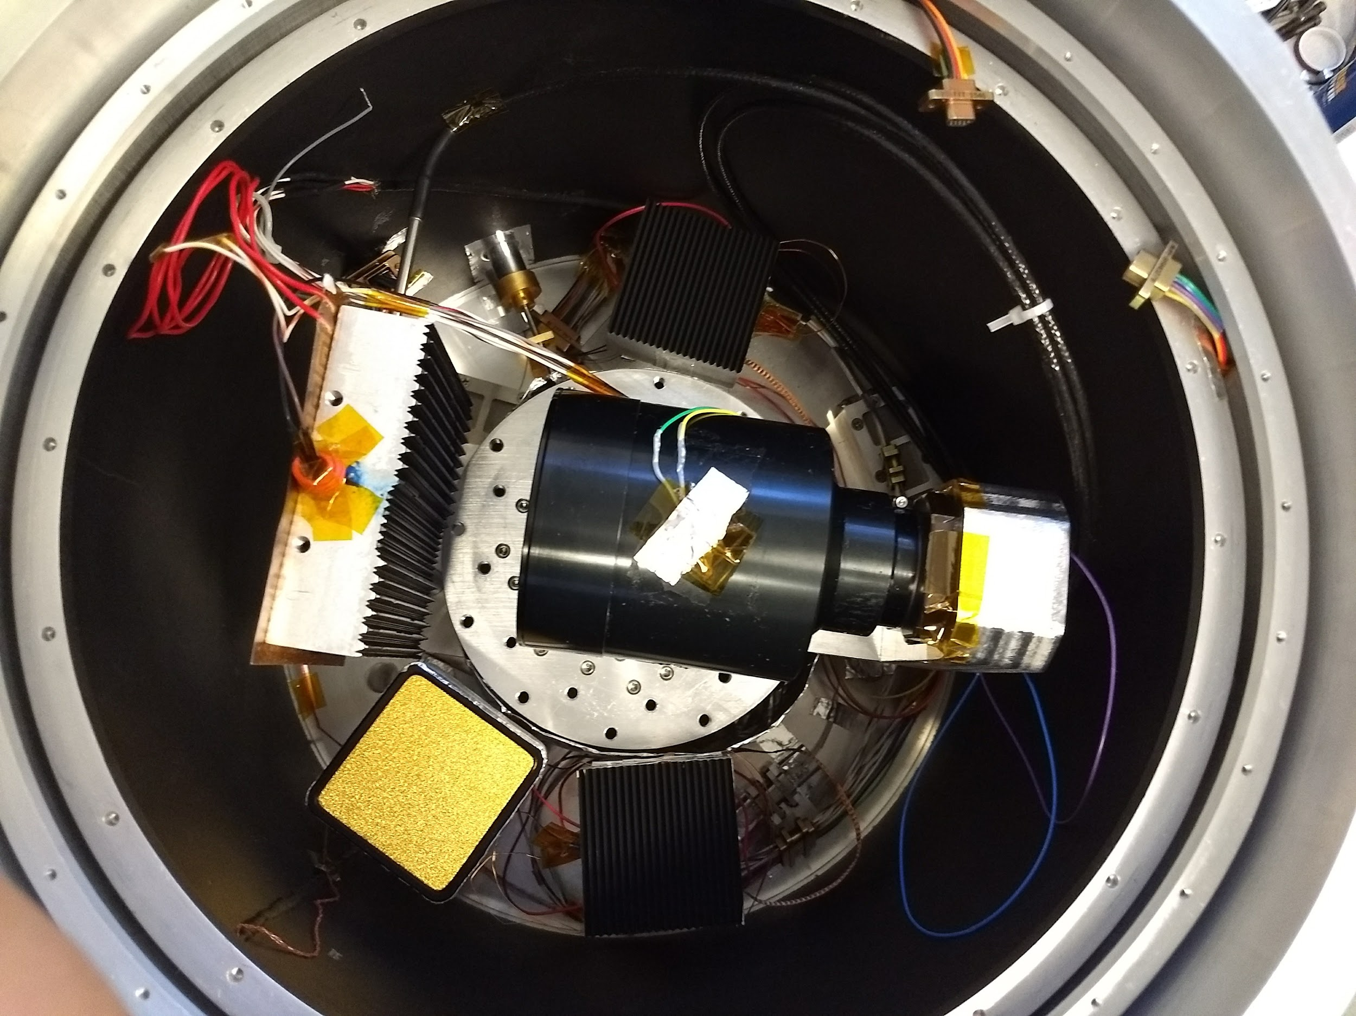
Thermal Vacuum Test - Setup (cont.)

Slide 7
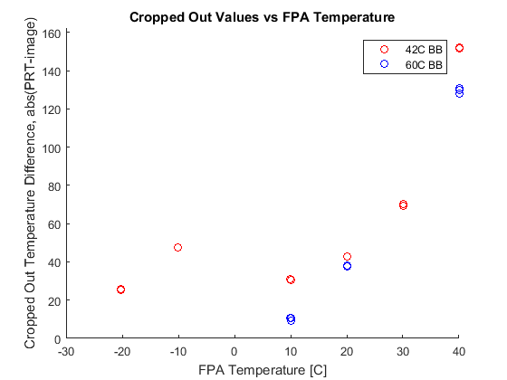
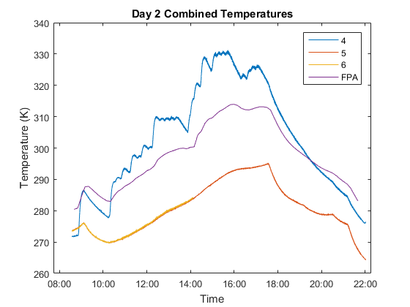
Thermal Vacuum Test - Results

Slide 8
Future Work

Slide 9
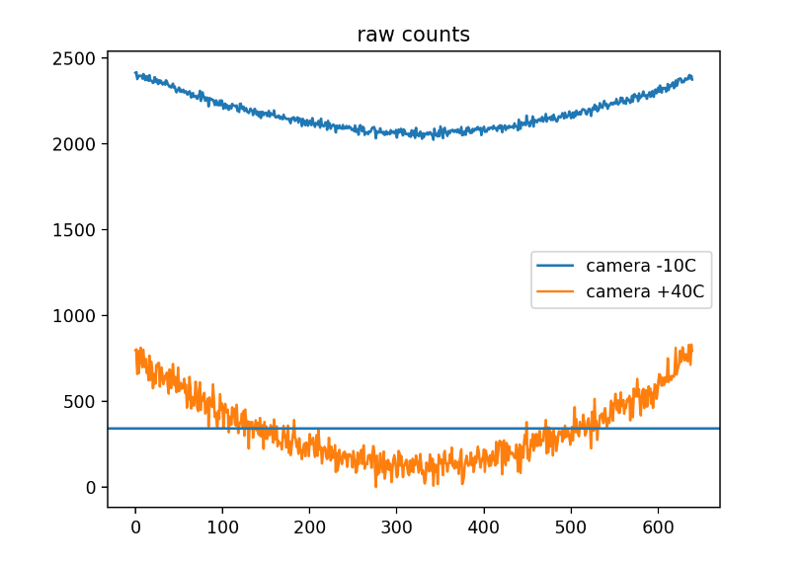
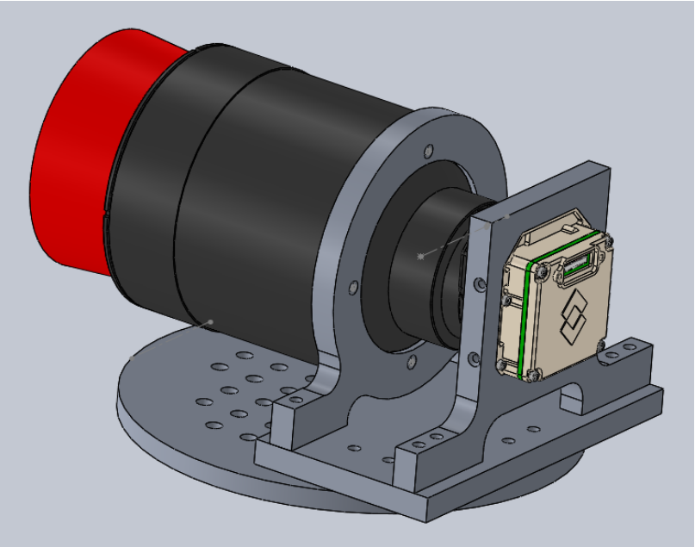
Thermal Vacuum Test - Possible Avenues of Error

Slide 10
Lunar Imaging

Slide 11
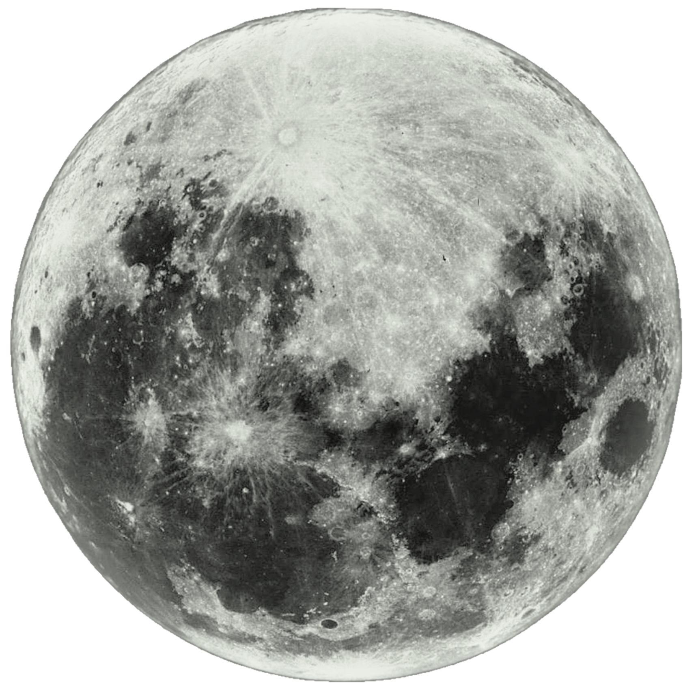
Lunar Imaging Test - Overview
Goal: To image the moon and come up with an atmospheric model to accurately measure surface temperature.
Reasoning: To try to recreate the conditions the camera will experience during flight.
  Image the moon at its zenith over Tempe, AZ

Slide 12
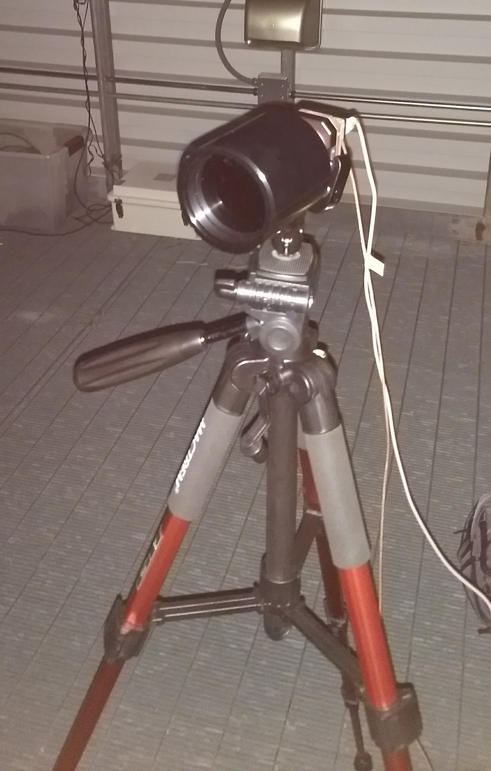
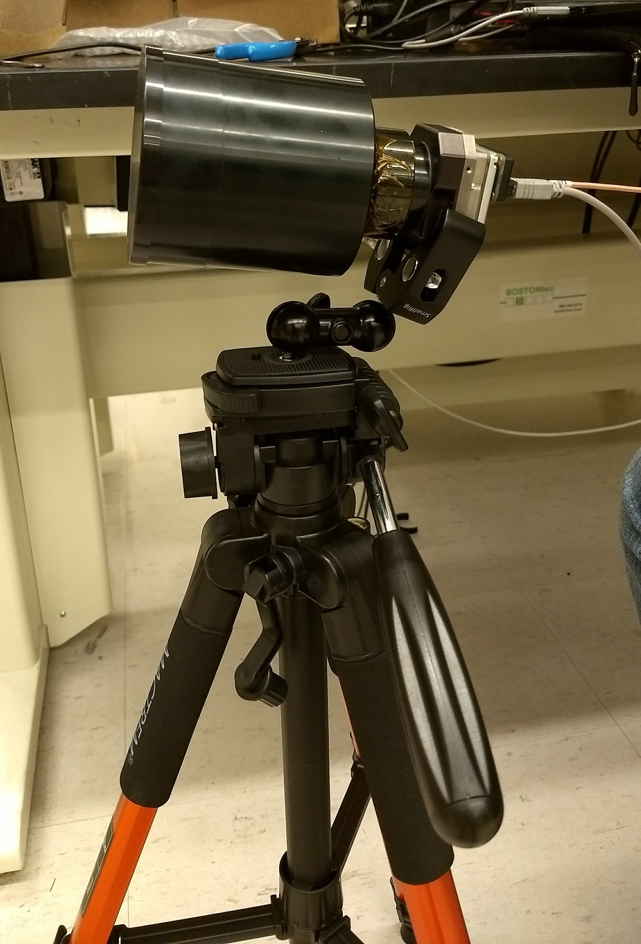
Lunar Imaging Test - Setup
Tripod mount with 3 axis alligator clamp

Slide 13
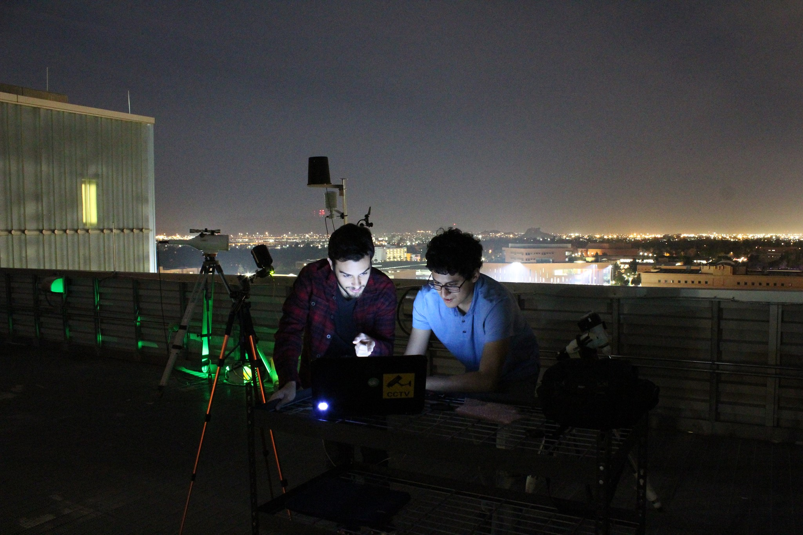
Lunar Imaging Test - Setup

Slide 14
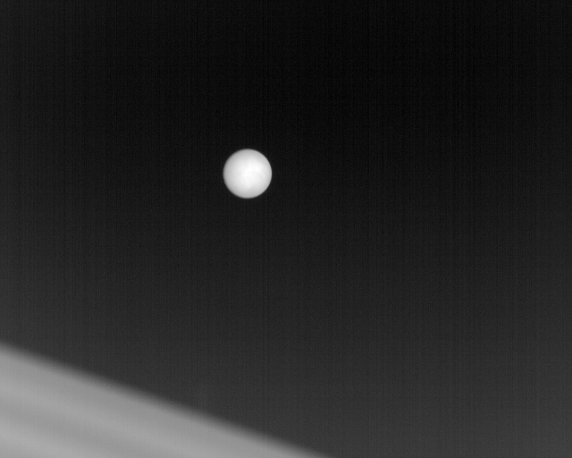
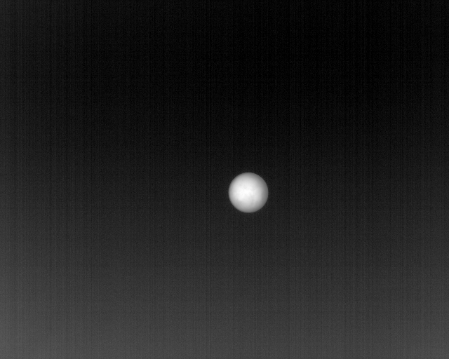
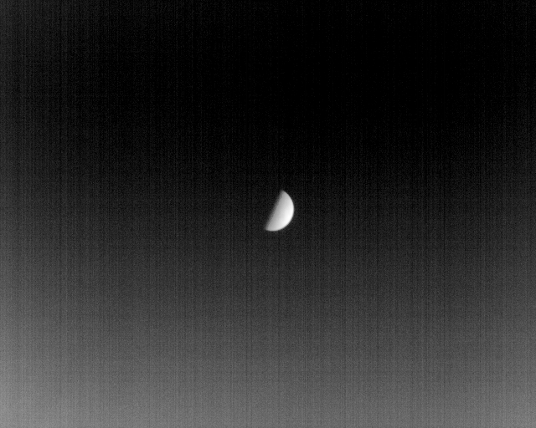
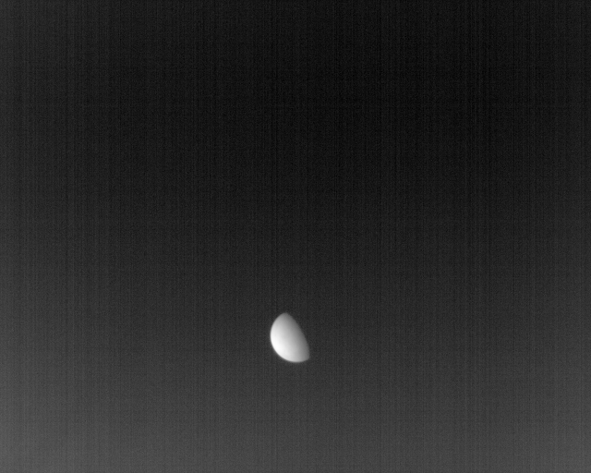
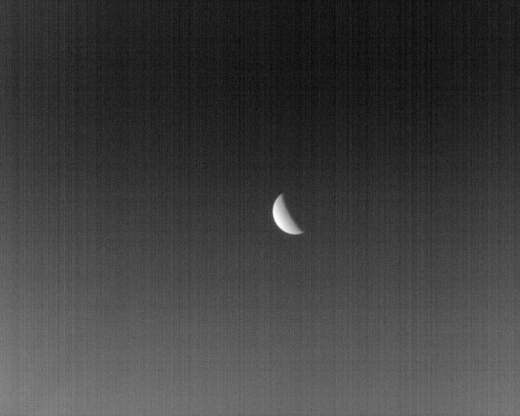
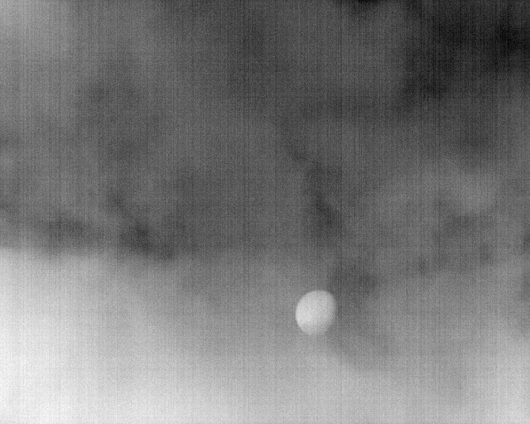
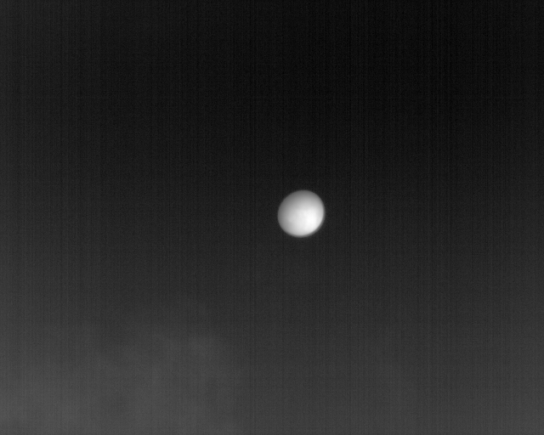
Lunar Imaging Test - Results

Slide 15
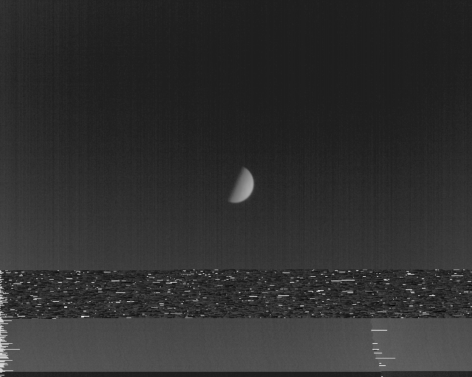
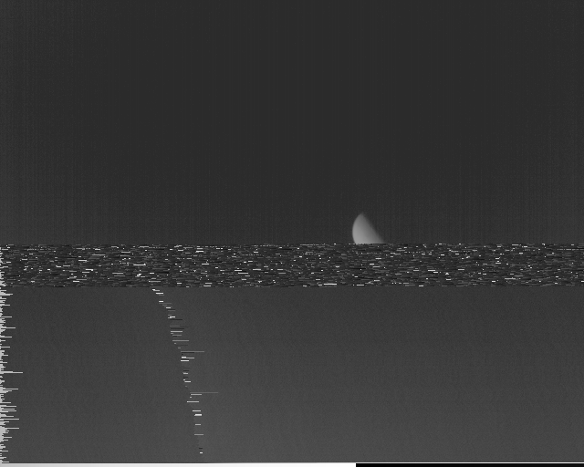
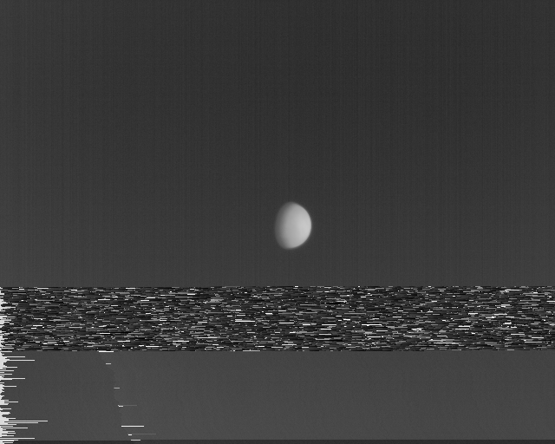
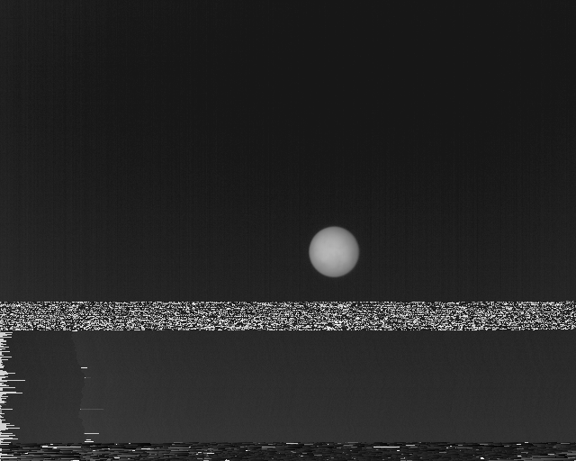
Lunar Imaging Test - Results

Slide 16
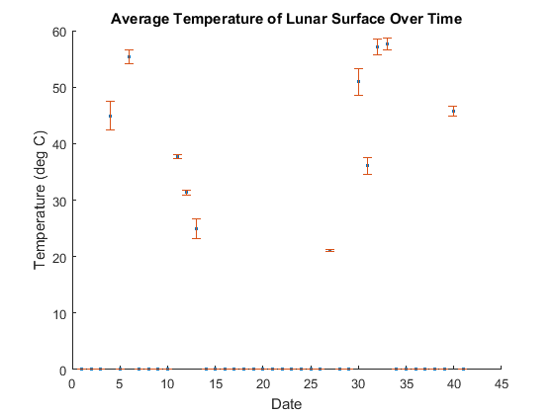
Lunar Imaging Test - Results
Start date corresponds Oct 1st, end day corresponds to Nov 10th

Slide 17
Future Work

Slide 18
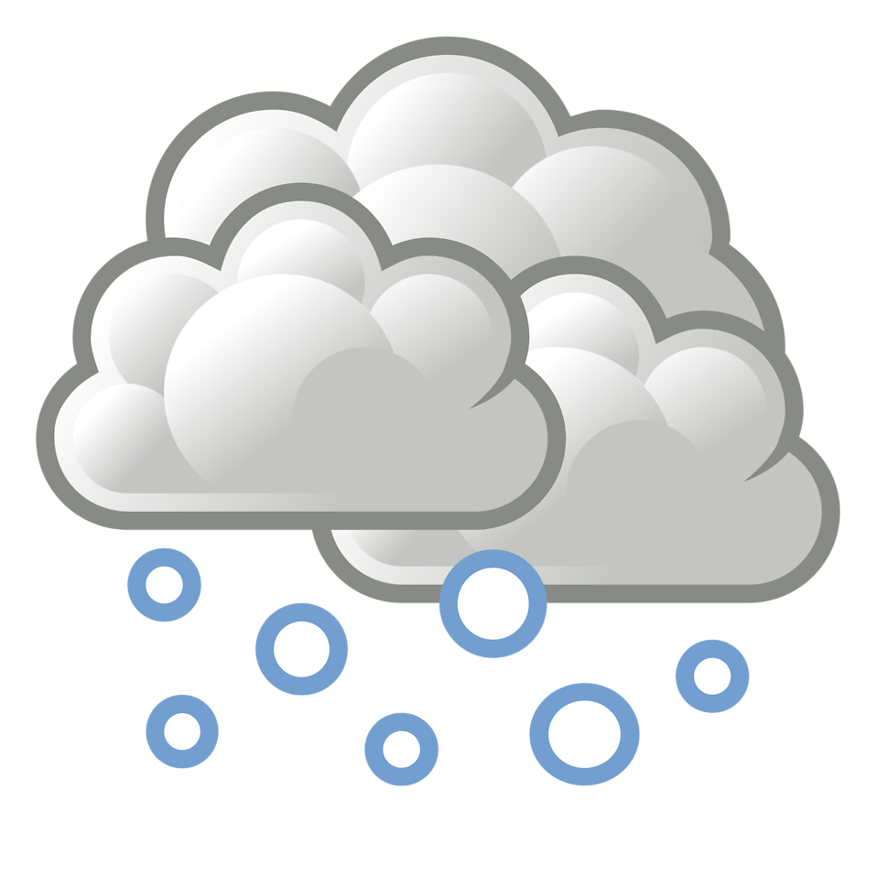
Lunar Imaging/Atmospheric Modeling
After addressing issues with thermal chamber testing, lunar imaging will be revisited for accurate modeling of atmosphere
More data will be taken
Will be tested with filter during cloudy day
  10.5-12.5μm

Slide 19
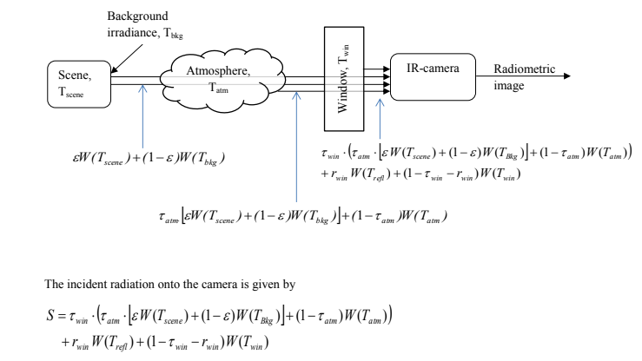
Manipulating the Raw Data from the Camera

Slide 20
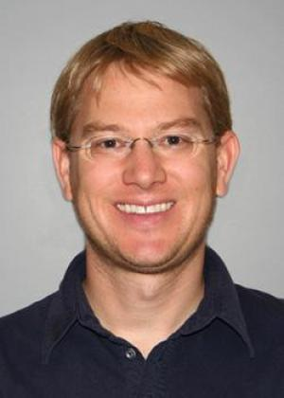
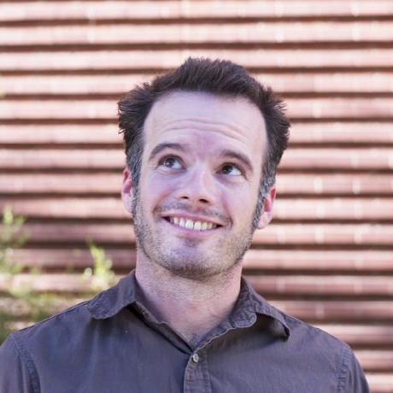



Acknowledgements
Judd Bowman
Mentor
School of Earth and Space Exploration
Danny Jacobs
Mentor
School of Earth and Space Exploration

Slide 21
Questions?

